Slide 1
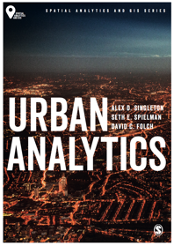
Network Analysis
Alex D Singleton, Seth E Spielman, David C Folch (2017) Urban Analytics. London: Sage.

Slide 2
Learning Objectives
How network representations provide a framework to explore the form and function of cities.
How objects, connections, and their attributes can be represented as nodes and edges within graphs.
Networks can represent both physical and relational aspects of human activities within urban systems.
A range of analysis techniques that enable insight to be extracted from network structures.

Slide 3
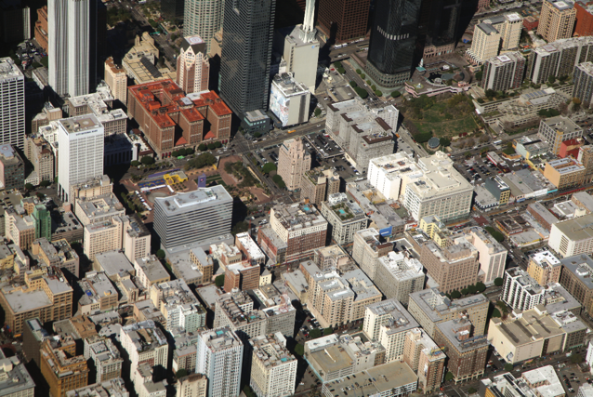
Space for Interaction
Space within a city is connected by physical networks
Aim to enhance accessibility and are typically configured to support various forms of transportation infrastructure
What other types of networks may exist in cities?
Streets form a network within Los Angeles that split and connect parcels of land
Source: Photograph by Doc Searls CC BY 2.0 (Flickr)

Slide 4
Network Structure
Node, vertex
Edge, face, link

Slide 5
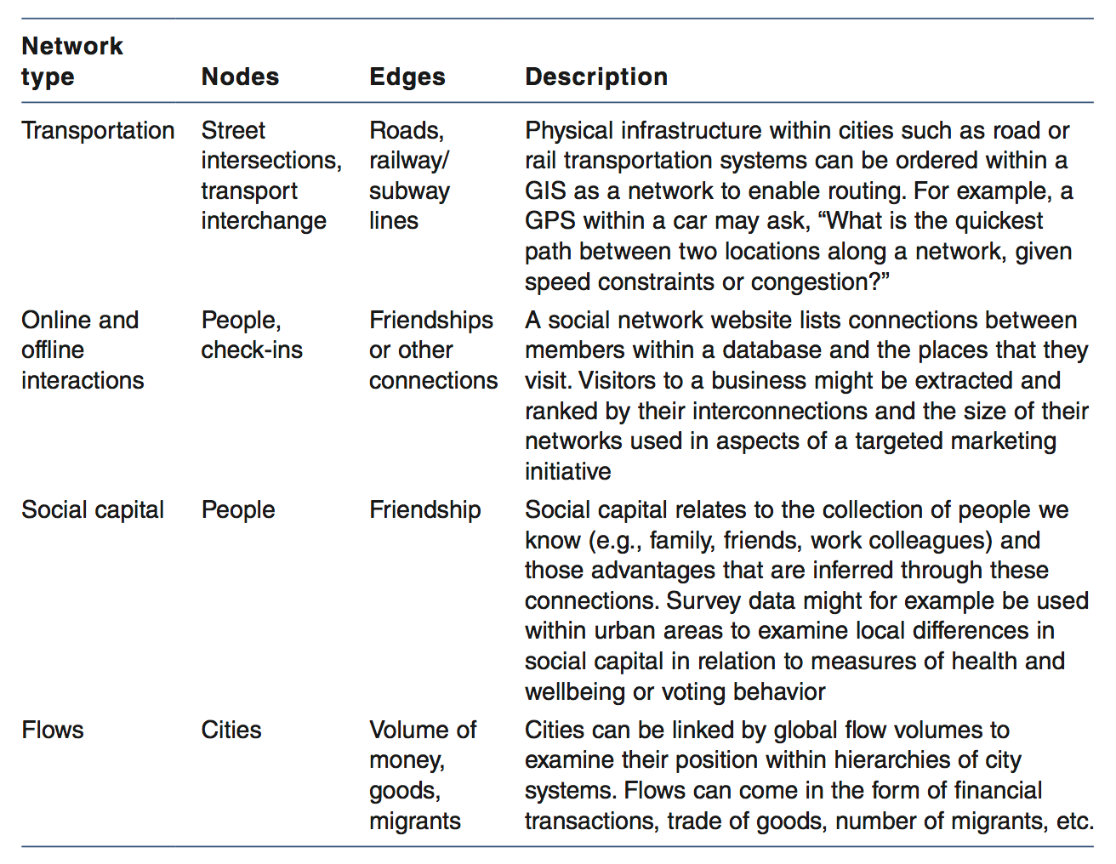
Some examples of networks of human activities within urban areas and their organization as nodes and edges

Slide 6
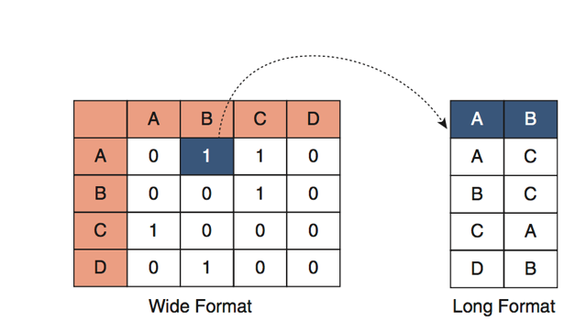
Inputs to a Network
Table detailing nodes and their relationships
Weighted or Unweighted
Long or short format
Directed or undirected
Various graph file formats
GML etc
Networks can be constructed, analyzed, and visualized using many different software packages
Wide and long-format input tables

Slide 7
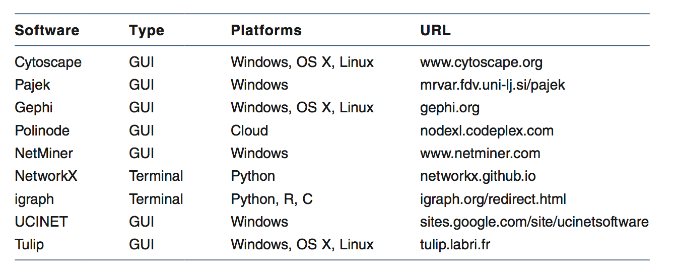
Network Software
Some examples of network analysis and visualization software tools

Slide 8
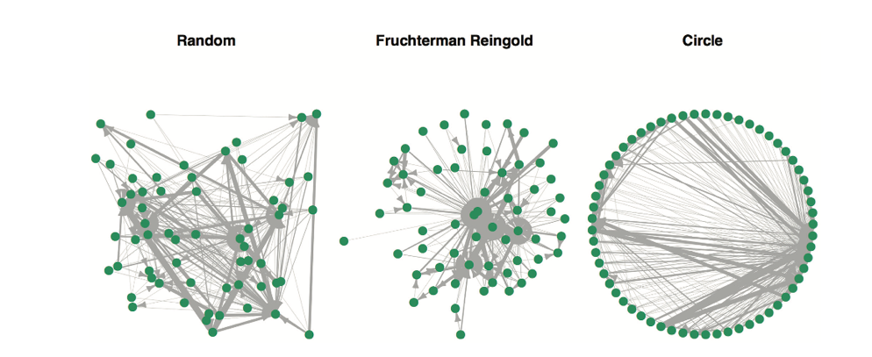
Network Visualization
The vast majority of network analysis tools will enable visualization of nodes and edges, often with a number of common style options including color, markers of directionality, or scaling of edges by different widths.
A directional and weighted network comprising nodes and edges displayed using three different layout algorithms

Slide 9
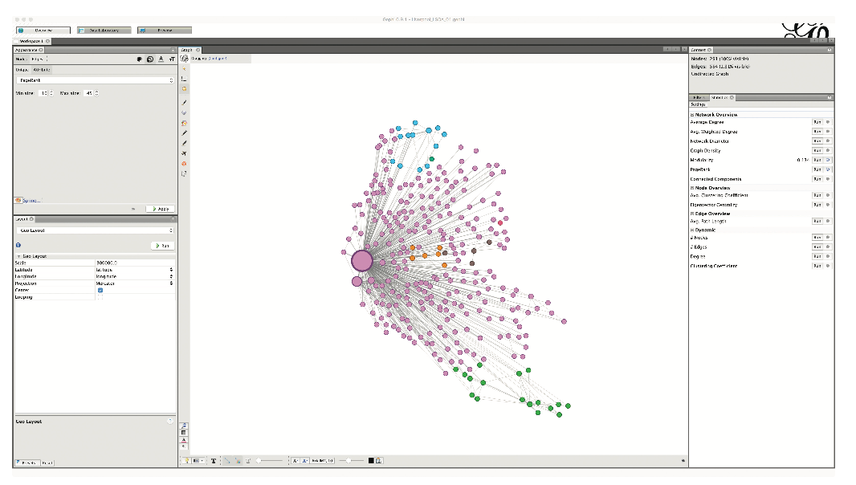
Network Visualization
Gephi is used to plot a network of Liverpool internal commuting as recorded in the Census of the Population. Nodes are organized by their geographic locations and represent census zone geography

Slide 10
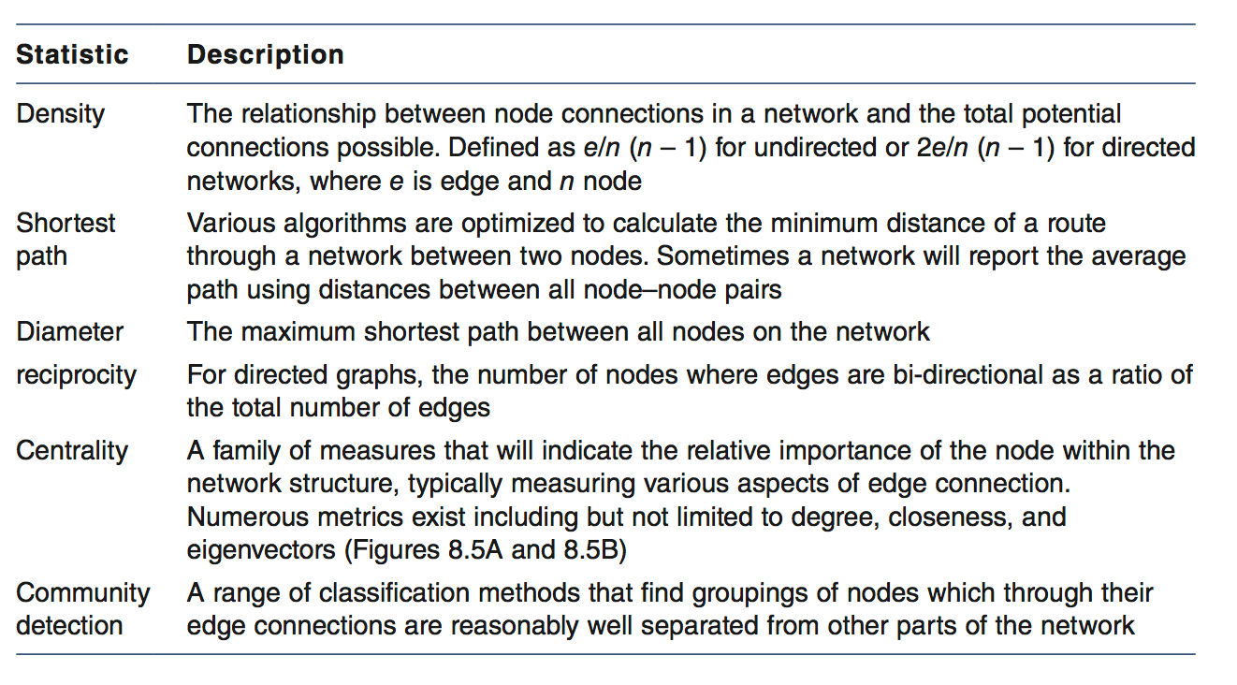
Describing a Network
Some common metrics used to describe the properties of networks

Slide 11
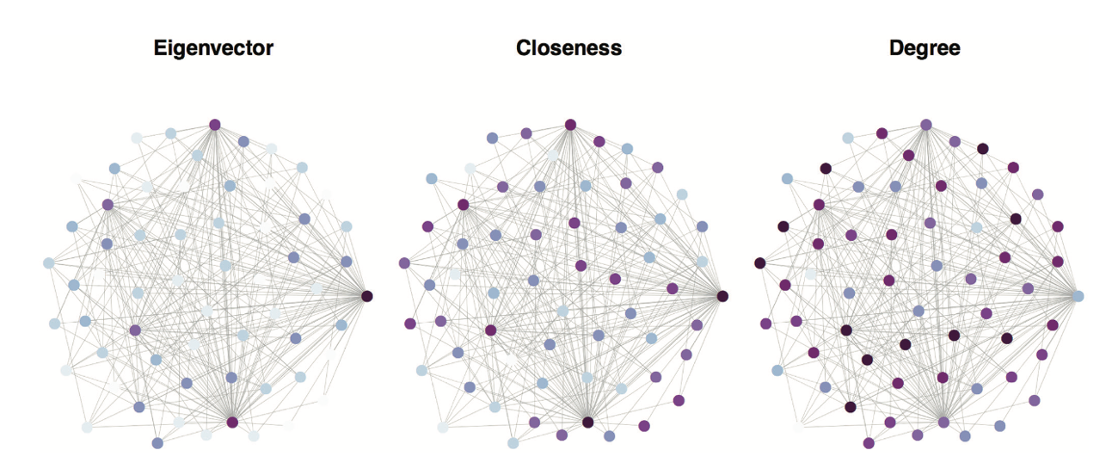
Describing a Network
Three network centrality measures calculated with color band break points uniformly selected, therefore maintaining the same network and layout in each example

Slide 12
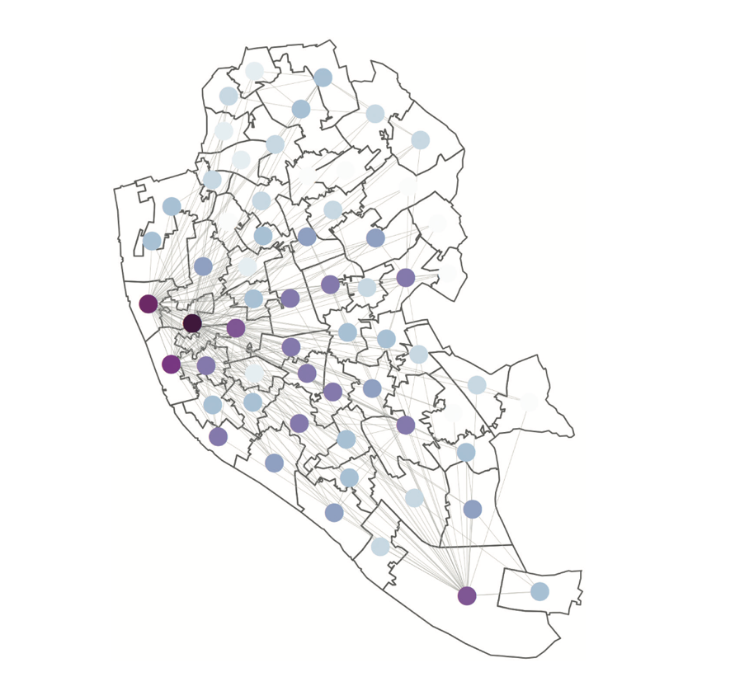
Describing a Network
Eigenvector centrality is plotted again with the same network and color options, but now the layout is arranged by the geographic location of the nodes (in this case, the centroid of a census zone geography for Liverpool and recorded commuting ow). The most highly connected nodes (with highest eigenvector values – the darker colors) predominantly cluster within the city center where the main areas for employment are located

Slide 13
Mobility and Human Dynamics
Predominately bound to fixed paths
Capacity constrained by the available infrastructure
When flow volume within a network nears capacity, mobility can slow or stop
Human dynamics relate to our interactions and movements within cities which occur over a variety of temporal scales

Slide 14
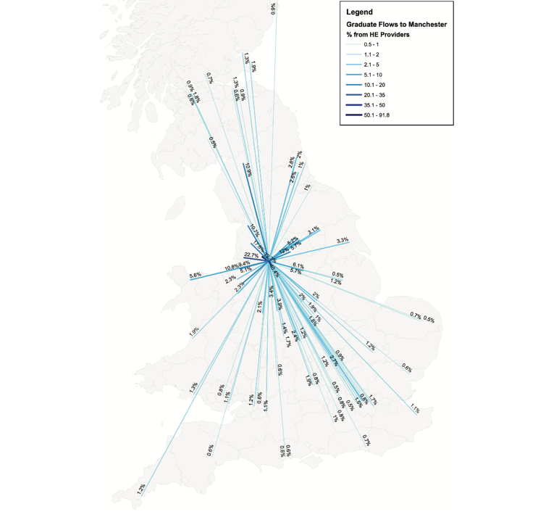
Mobility and Human Dynamics
The flow of graduates from Manchester to their first destinations of employment as recorded by the UK Higher Education Statistics Agency
Source: Duncan Smith (citygeographics.org). Reprinted with permission.

Slide 15
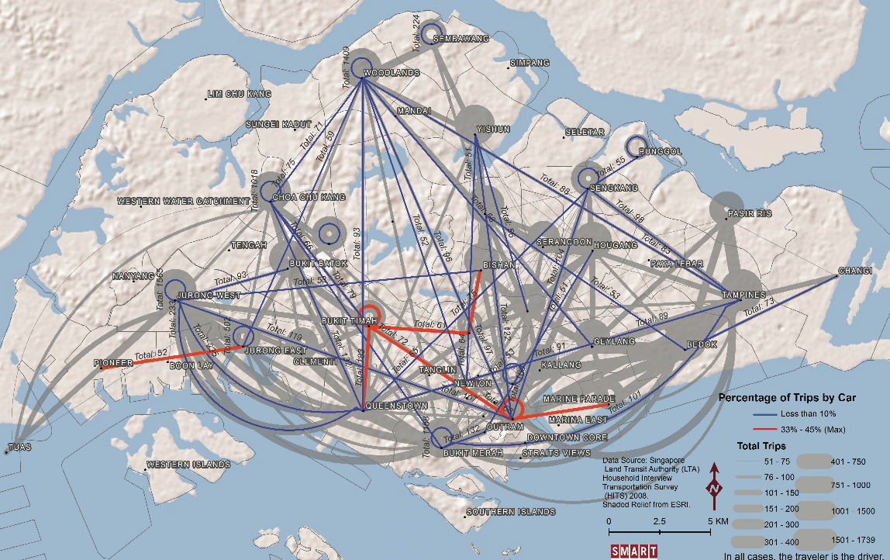
Mobility and Human Dynamics
The FLow of car journeys within Singapore
Source: Clio Andris (https://sites.google.com/site/clioandris)

Slide 16
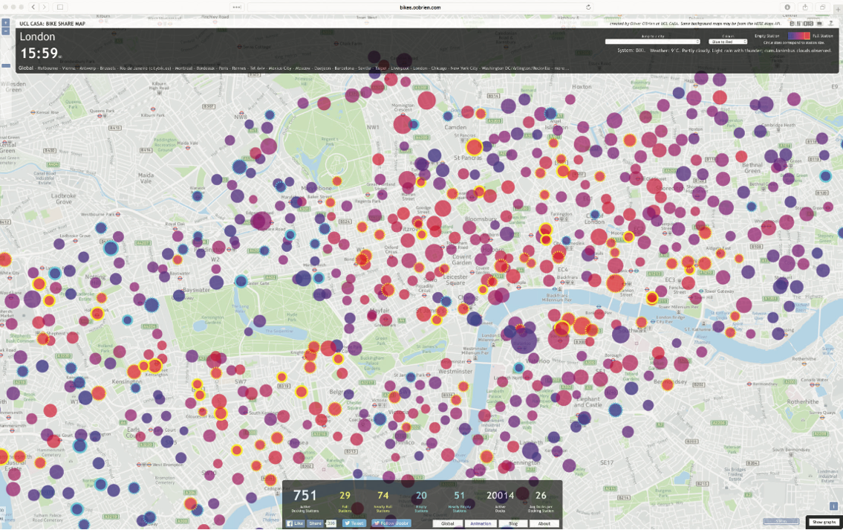
Mobility and Human Dynamics
Fast human dynamics recorded through a live bike share map for London Source: Oliver O’Brien, University College London, http://bikes.oobrien.com/. Reprinted with permission.

Slide 17
Disruptive Effects of Networks
Uber
“transportation network company” (Utilities 2013)
directly connects passengers with drivers through a mobile platform.
Users of the Uber app are linked into a network of drivers providing services within the requested locality.
Enables ride sharing

Slide 18
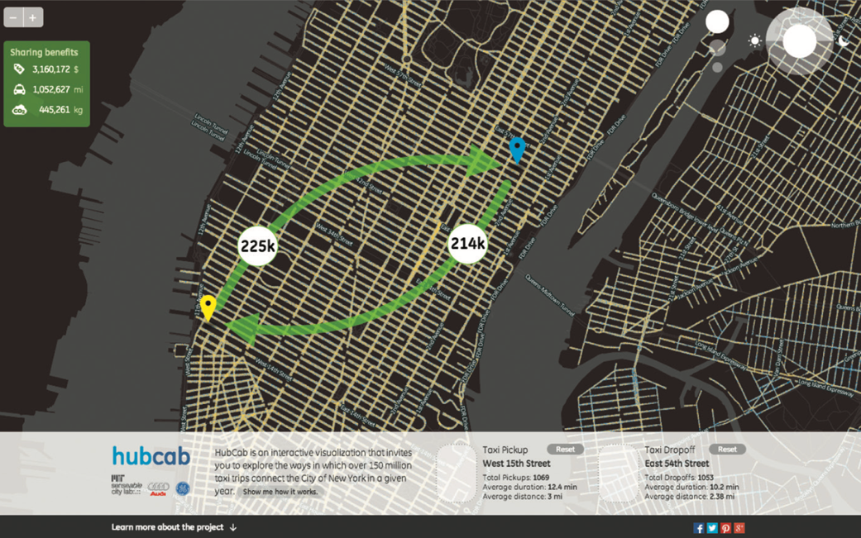
Disruptive Effects of Networks
Visualization on the hubcab.org website, illustrating cab-sharing bene ts generated from analysis of 170 million taxi cab trips over a year within NYC
Source: MIT Senseable City Lab – hubcab.org. Reproduced with permission.

Slide 19
Networks and Urban Morphology
The spatial arrangement of built features within cities and the dynamic processes through which they are created are often referred to as urban morphology.
Physical networks such as road infrastructure are morphological features
Urban morphology is therefore linked to social inter- action by enhancing or constraining relationships between people
Interrelationship between urban morphology and behavioral outcomes has long been the focus of much research within urban design and planning

Slide 20
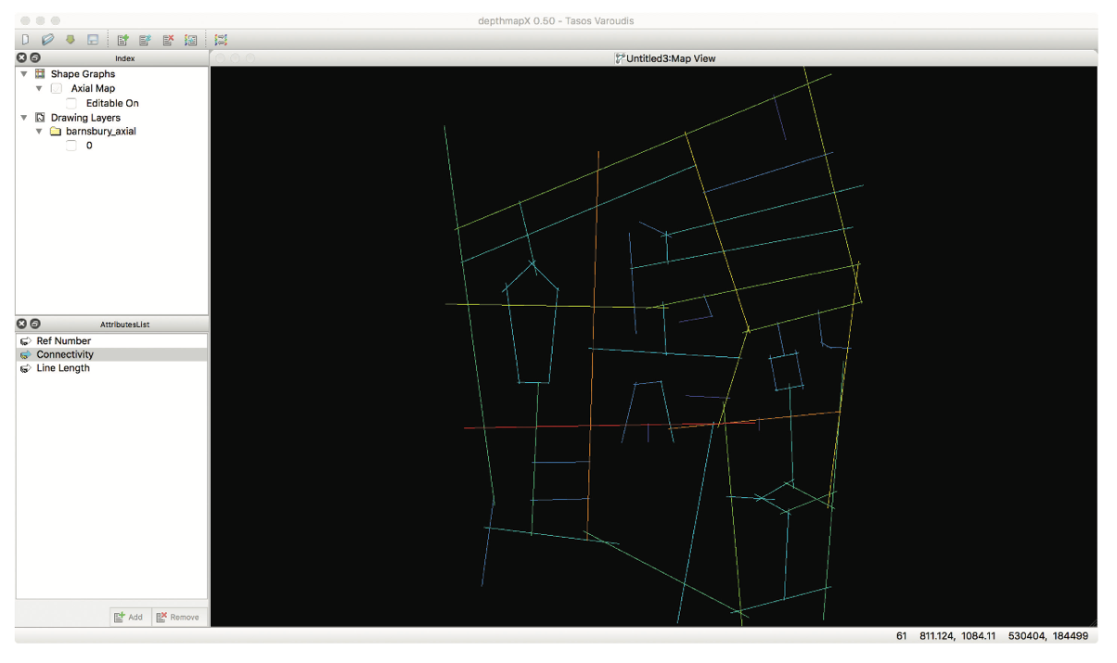
Networks and Urban Morphology
DepthmapX software showing axial lines derived for a section of streets in London
Source: DepthmapX – https://varoudis.github.io/depthmapX/,

Slide 21
Networks and Human Progress
Networks provide a mechanism for rapid communication between citizens, which can take a number of forms.
Exchange of information between all members or limited specific subgroups, and can be made up of different mixes of virtual or real-world connections.
Examples
AMBER Alerts
Open Data
311 Calls

Slide 22
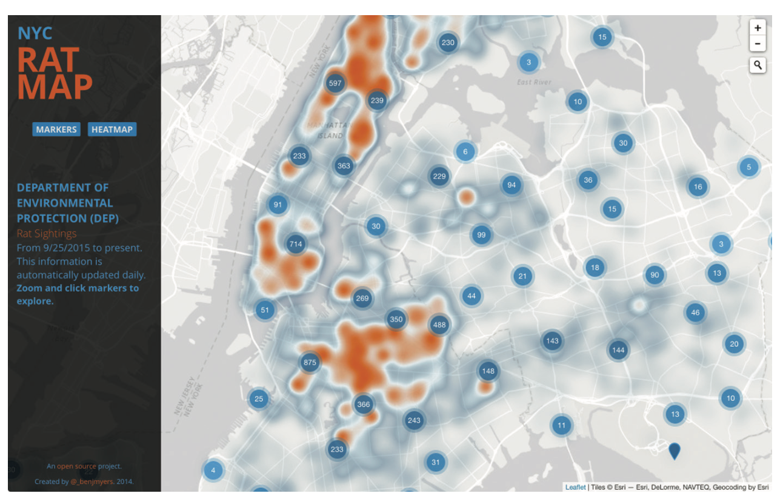
A map of rat sightings in New York created using 311 Open Data Source: Benjamin E. Myers (http://benjmyers.com/ratmap/#/),

Slide 23
Conclusions
Networks can be used to represent different aspects of the built and social structure of cities
The properties of networks can be rendered visible through Visualization and descriptive analysis
They have a range of different applications within urban areas

